Slide 1
Incorporating time in cSTMs
Decision Modeling for Public Health
December 2022

Slide 2
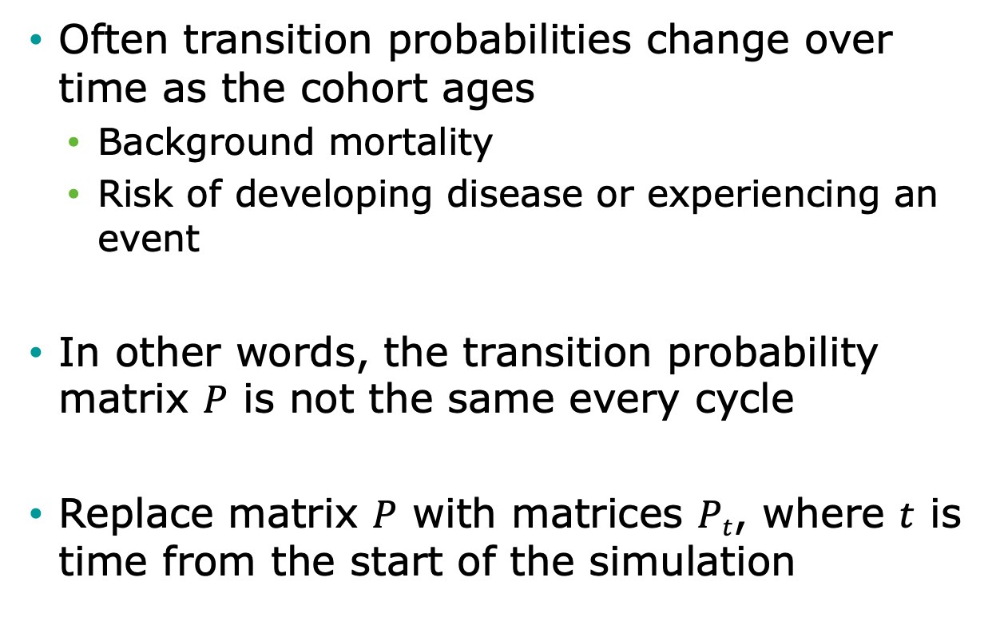
Time-Varying Probabilities
Often transition probabilities change over time as the cohort ages
Background mortality
Risk of developing disease or experiencing an event
In other words, the transition probability matrix $P$ is not the same every cycle
Replace matrix $P$ with matrices $Pt$, where $t$ is time from the start of the simulation

Slide 3
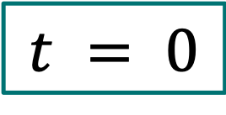
Three-State Model
0.05
0.93
p_HS
0.90
1 - 0.02 - 0.05
1 - 0.10
p_HH
p_SS
Healthy (H)
Sick (S)
$$t = 0$$
p_HD
p_SD
0.02
0.10
Dead (D)
To:
 | Healthy | Sick | Dead
Healthy | 0.93 | 0.05 | 0.02
Sick | 0 | 0.90 | 0.10
Dead | 0 | 0 | 1.0
p_DD
1.0
From:

Slide 4
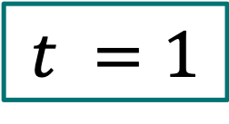
Three-State Model
0.05
0.92
p_HS
0.88
1 - 0.02 - 0.05
1 - 0.10
p_HH
p_SS
Healthy (H)
Sick (S)
$$t =1$$
p_HD
p_SD
0.03
0.12
Dead (D)
To:
 | Healthy | Sick | Dead
Healthy | 0.92 | 0.05 | 0.03
Sick | 0 | 0.88 | 0.12
Dead | 0 | 0 | 1.0
p_DD
1.0
From:

Slide 5

Three-State Model
0.05
0.91
p_HS
0.86
1 - 0.02 - 0.05
1 - 0.10
p_HH
p_SS
Healthy (H)
Sick (S)
$$t =2$$
p_HD
p_SD
0.04
0.14
Dead (D)
To:
 | Healthy | Sick | Dead
Healthy | 0.91 | 0.05 | 0.04
Sick | 0 | 0.86 | 0.14
Dead | 0 | 0 | 1.0
p_DD
1.0
From:

Slide 6

Simulating Cohort with Time-Varying Probabilities
Cohort distribution at next time step is still calculated through matrix multiplication, but matrix changes over time
Transition Probability Matrix
$$P_{t}$$
x_{t+1}
=
x_{t}

Slide 7
History Dependence
Notes:
Part 1 = Showing code 3 state model
Part 2 = Exercise build Sick-Sicker model
Part 3 = Show answers of Sick-Sicker

Slide 8
History Dependence
“Memoryless” property of state transition models is a BIG assumption
Transition probabilities only depend on the current state and not on past states
Many transition probabilities depend on model history, not just time since model start
Risk of myocardial infarction (MI) greater for persons with prior MI
Effectiveness of a drug used as first-line therapy may be better than if used as second-line therapy

Slide 9
When history matters, create more states…
Healthy – Sick - Dead:
Once recovered, the risk of getting sick again or dying increases
Healthy (H)
Sick (S)
Dead (D)
Healthy (H)
Sick (S1)
Recovered (R)
Dead (D)
Healthy – Sick – Recovered - Dead

Slide 10

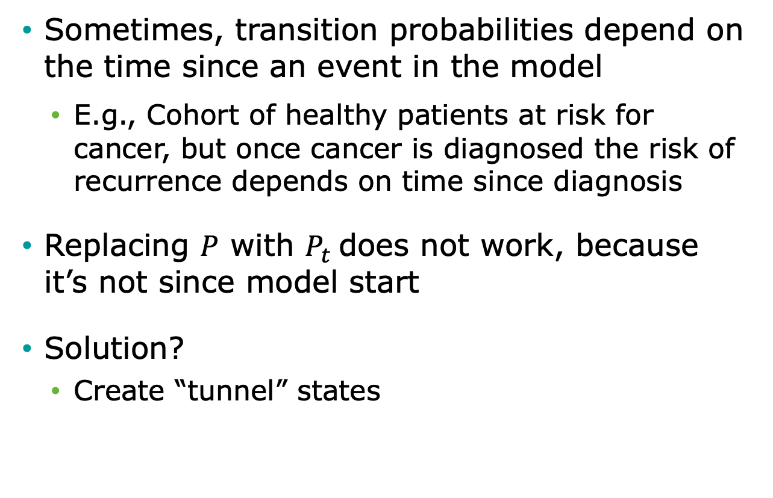
Tunnel states
Sometimes, transition probabilities depend on the time since an event in the model
E.g., Cohort of healthy patients at risk for cancer, but once cancer is diagnosed the risk of recurrence depends on time since diagnosis
Replacing $P$ with $P_{t}$does not work, because it’s not since model start
Solution?
Create “tunnel” states

Slide 11
State Time
f(model time)
f(state time)
Healthy
Cancer
Recur
Dead
Tunnel state

Slide 12
Tunnel States
p_Recur₁
Cancer 1
p_Recur₂
Cancer 2
p_Recur₃
Cancer 3
Recur
p_Recur₄
Cancer 4
p_Recur_{n}
Cancer n
Transitions to Dead also allowed.

